Slide 1
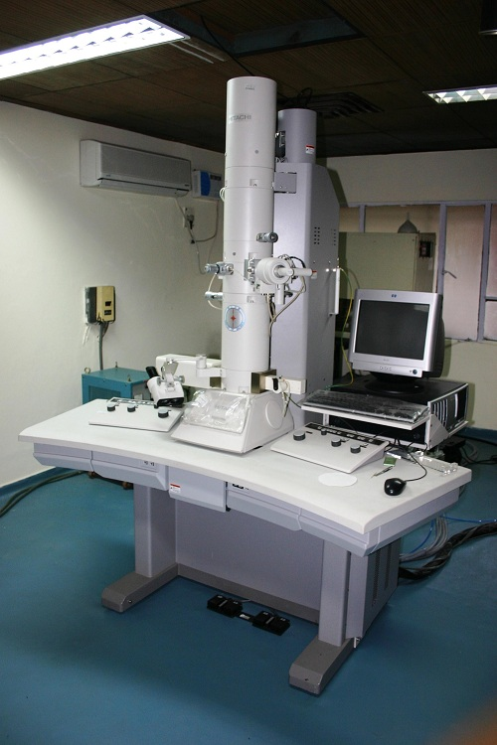
Transmission Electron Microscope (TEM) -uses electrons, but instead of scanning the surface (as with SEM) electrons are passed through very thin specimens.
TEM = "thin"

Slide 2
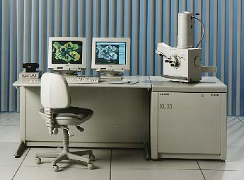
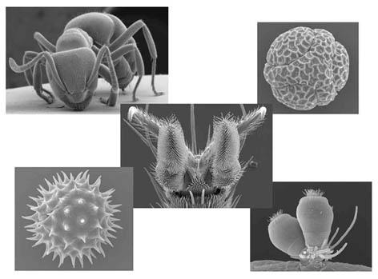
Scanning Electron Microscope (SEM) - allows scientists to view a universe too small to be seen with a light microscope. SEM does not use light waves; it uses electrons (negatively charged electrical particles) to magnify objects up to two million times. SEM creates a 3D view of specimen, but cannot view living specimens (process kills them)

Slide 3
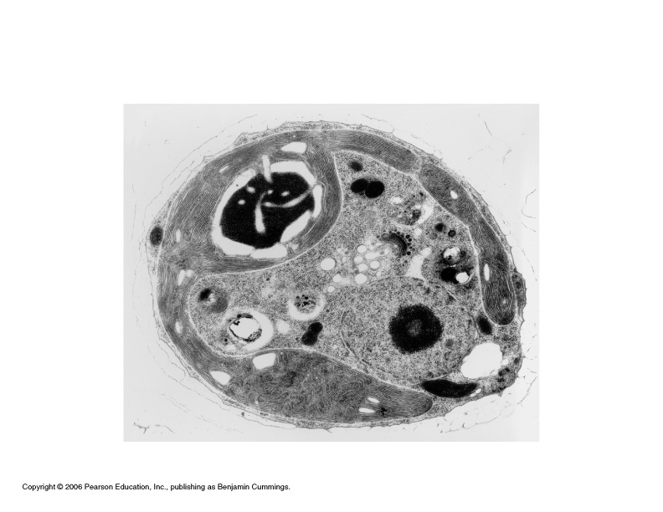
TEM of a cell, notice you see the inside of the cell and not the surface

Slide 4
Microscope Resources
Virtual Microscopes (Phase Contrast, Fluorescence, TEM, SEM) at -
http://nobelprize.org/educational/physics/microscopes/1.html
Nanoworld Image Gallery
Microworld Images

